Slide 1
IT and Tech Roundtable
Spencer Tuohy

Slide 2
Summary of Items to Be covered
What is Sitelink Myhub? How can I use it?
What are most common IT issues? How do I get help?
Who do I email?
What is considered emergency (aka need fix right away)? Email then call
What to do on a weekend?
Easy things I can try myself before requesting help
What is TeamViewer and how is it used?

Slide 3
What is Sitelink Myhub?
https://myhub.smdservers.net/Account/Login?ReturnUrl=%2f
How is it used?
Nearly same as web edition just an online version
More visual reports
Login is same as web edition
Ability to take payments, do daily closes, export reports etc, take tenant notes
Quicker than loading up web edition

Slide 4
Common IT Issues
Email is not working
Gate is down
Printer stopped printing, scanning, etc
Computer is not working or has crashed
Sitelink not working
Pin pad is down
Any other issues?

Slide 5
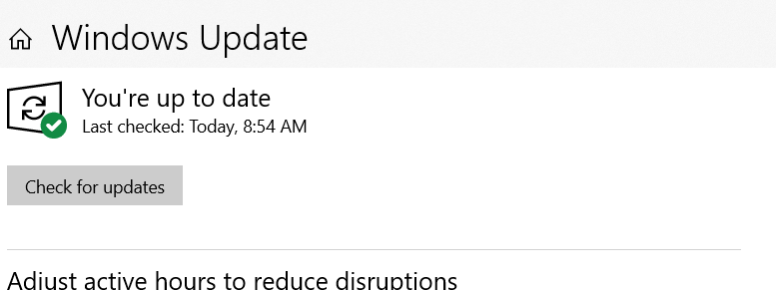
Easy things to try before requesting help
Try completely shutting down your computer
Unplug your printer and plug it back in
Check for windows updates
Magnifying glass type updates
Run windows updates and install after installation is complete computer will request restart to install update

Slide 6
What is considered an Emergency?
My computer wont boot up or isn’t turning on (power has been checked)
Gate will not connect? Storlogix is offline and not reading new codes
My email is down and not sending/receiving emails
A technician is on site to fix your internet or phone

Slide 7
How do I get help?
Email your DM along with helpdesk@tntmgmt.com (unless computer won’t boot up)
If it is the weekend and you have emergency IT situation
Text (714) 356-4196 along with your DM
I can usually handle something within a few hours
I have not received a response over 2 hours
Call DM & DM will let you know to call Spencer or not

Slide 8
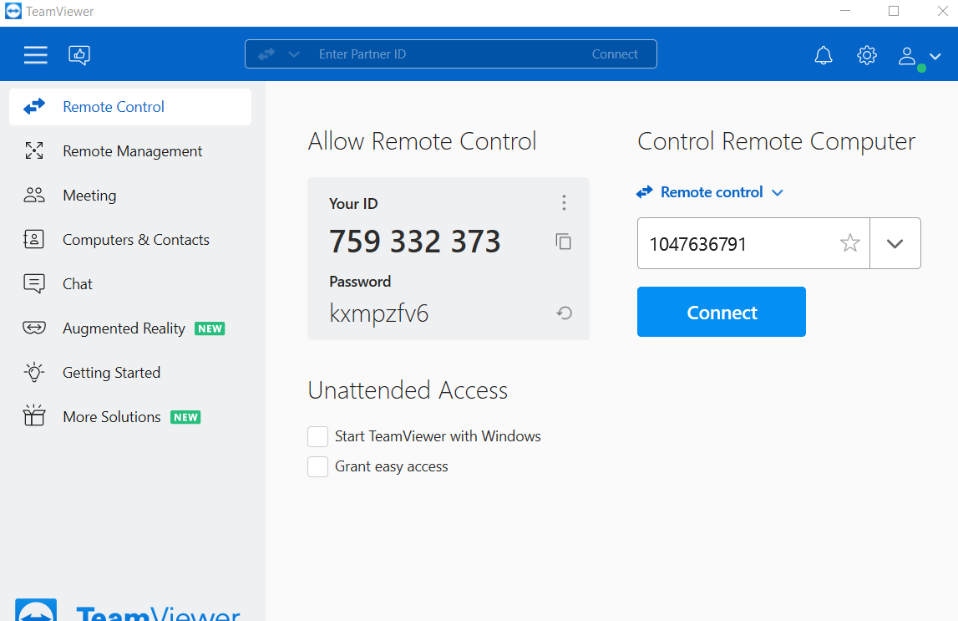
What is TeamViewer? How do I use it?
Teamviewer allows Spencer, Kevin or Ruben to access your computer remotely.
You send “Your ID” & “password”
You must keep it open otherwise it does not allow remote access and the password changes

Slide 9
Questions?
Sign up list to test myhub for a full day on 10/26/2022

